Slide 1

DEDAN KIMATHI UNIVERSITY OF TECHNOLOGY
INSTITUTE OF GEOMATICS, GIS & REMOTE SENSING (IGGReS).
DEVELOPMENT OF A WEB BASED LIVESTOCK SPATIAL DECISION SUPPORT SYSTEM.
Name : MURIITHI DERRICK MUTWIRI
REG NO: E031-01-0867/2013
DATE : 07/12/2017

Slide 2

Introduction
Kenya is an economically and agriculturally sustained.
Livestock in Nyeri county plays an important role in the economy.
Animal products have growing economic significance.
Livestock Management involves the overall productivity, management, improvement and planning for livestock resources.
This LDSS aspires to address solutions and can be utilized for management, analysis, visualization and dissemination of information available on the livestock in Nyeri county.

Slide 3
Problem Statement
Inadequate of quantitative and quantitative spatial data on livestock.
Inadequate proper means for reporting major cases on livestock such as disease outbreaks.
Livestock disease outbreak mapping, trends and prediction due to lack of data.
Coordinating and planning activities such as vaccination and emergency response challenges.
Mapping diseases outbreaks and monitoring trends of animal diseases.

Slide 4
Objectives
Main Objective
To develop a web based livestock spatial decision support system.
Specific objectives.
To model and develop a livestock spatial database.
To create a web-Geo portal for data management and decision making.

Slide 5
Study area.
STUDY AREA DESCRIPTION
Nyeri county area is 3337sqkm.
Borders 5 counties namely;
Kirinyaga to the east, Nyandarau to the west, Murang’a to the south, Laikipia to the north and Meru to the northeast.
It constitutes five constituencies; Nyeri town, Tetu, Kieni, Mathira and Mukurweini.
Geographic location (0° 25’ 12" S ,36° 56’ 51" E)

Slide 6
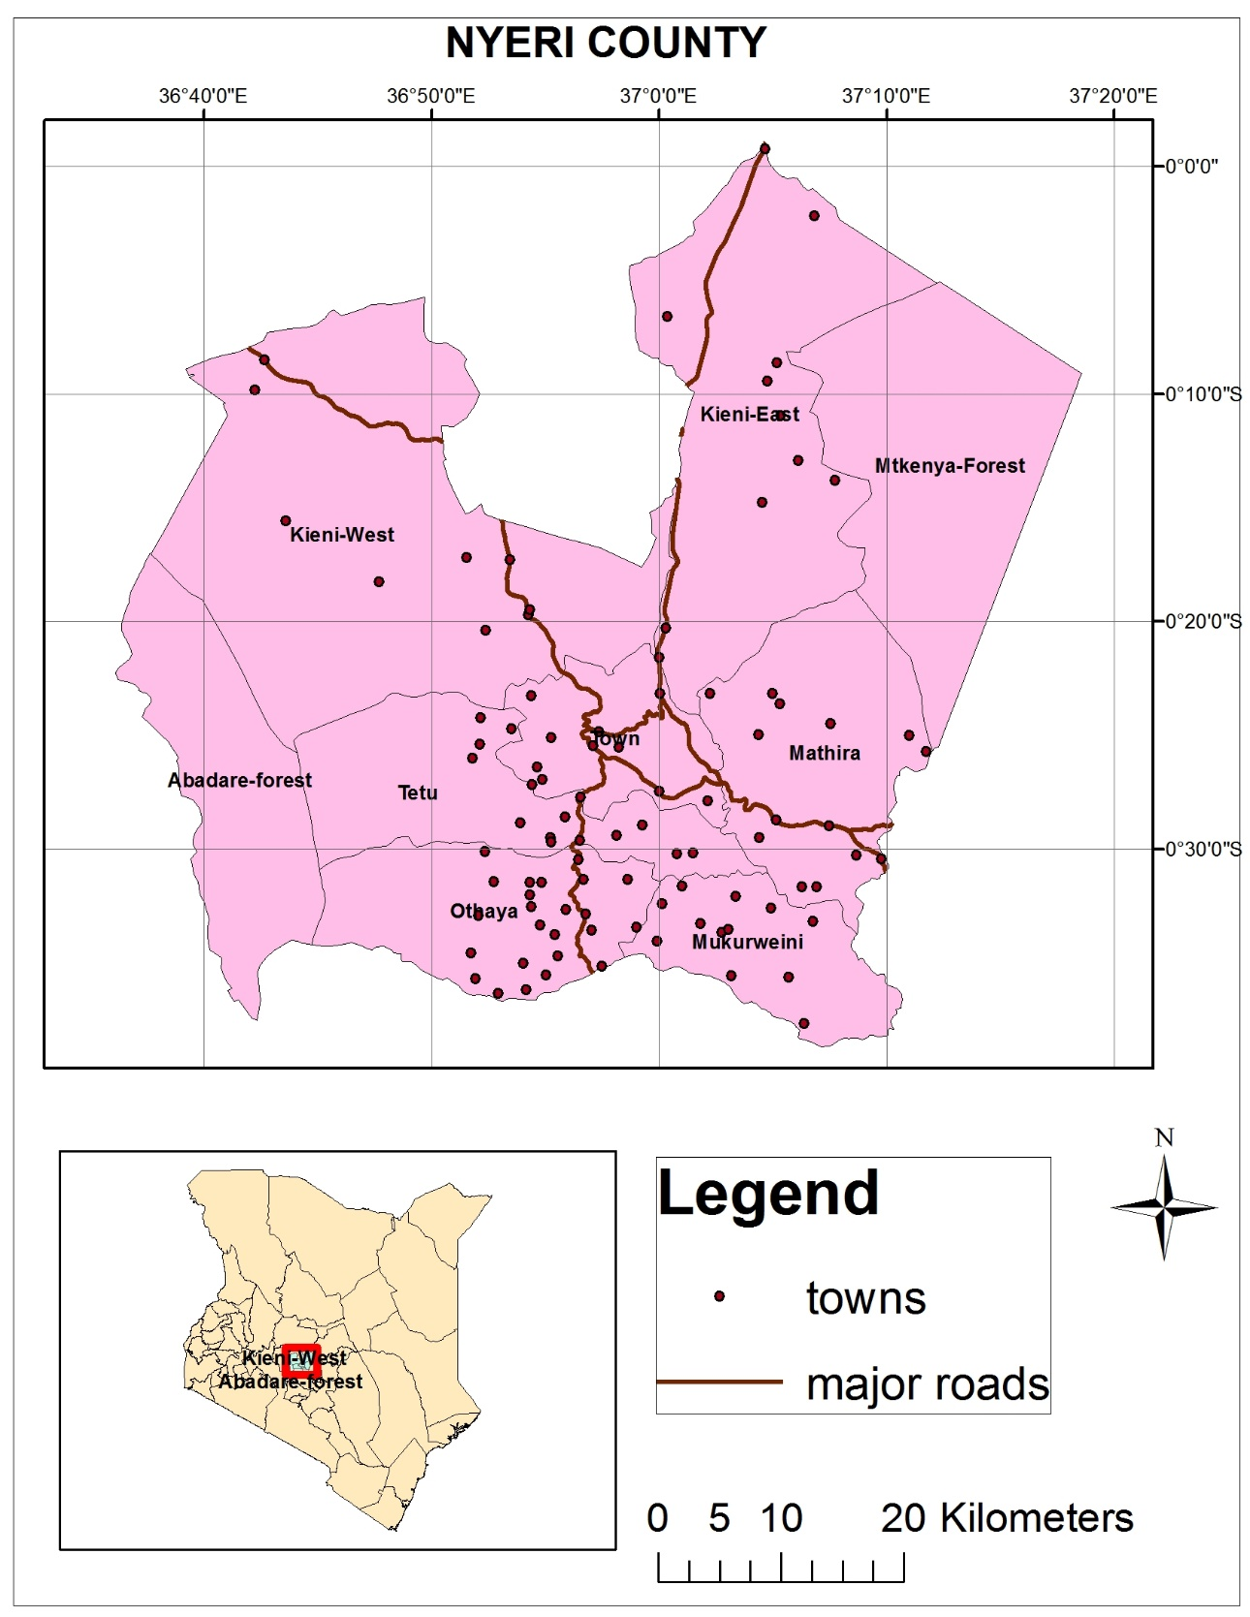
Study area map.

Slide 7
Justification
Challenge in planning for the existing livestock activities, resources and facilities.
Need to integrate Gis in livestock management for purposes of mapping, visualization and spatial analysis.
Need to create and share both spatial and meta-data on livestock to other stakeholders.
Need for improved reporting on livestock.
Need to map livestock at a local scale for generation of qualitative data.

Slide 8
Project scope
The study will entail.
Creation of data with location aspects.
Queries, filters and search operations.
Spatial analysis such as buffer analysis and nearest feature analysis.
Routing and geolocation capabilities .
Reporting animal disease incidences.
Production and visualization of statistical reports.
Mapped variables include:
Livestock population
Facilities
Corridors
Animal products.
Livestock markets.
Disease incidences.

Slide 9
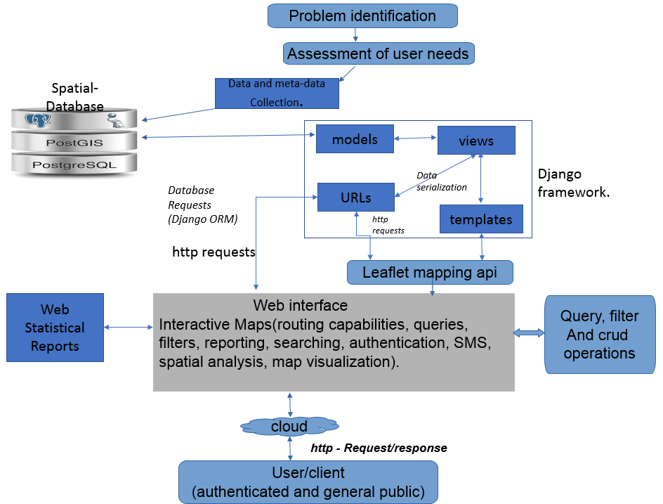
METHODOLOGY

Slide 10
Data and tools.
Data
Tools.
Spatial database – Postgresql with postgis.
Server – simple python server.
GIS software – QGIS software(for data creation and editing).
Web mapping APIs – leaflet js.
Web programming languages – Html, javascript, css, bootstrap.
Frameworks – python- Django(Geo-django).
Data | source | resolution | Coverage | Use.
Towns, Sub-counties shapefiles | Kenya Data portal | varied | Nyeri County | base maps.
Metadata and attribute Data. | Livestock department. | varied | Study area | Database and Forms design.

Slide 11
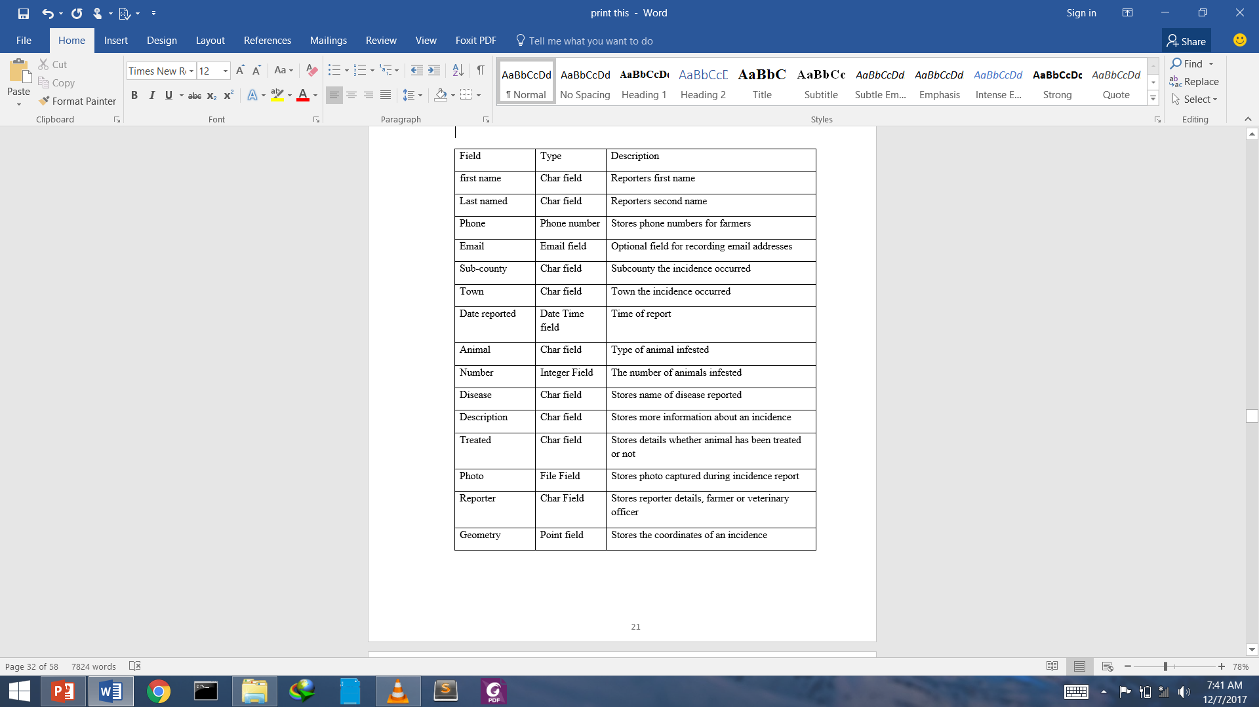
Results 1.Modelling.(Django).

Slide 12
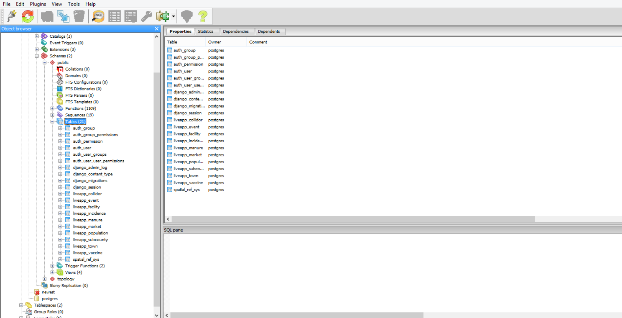
2.Livestock Database(postgres with postgis. ).

Slide 13
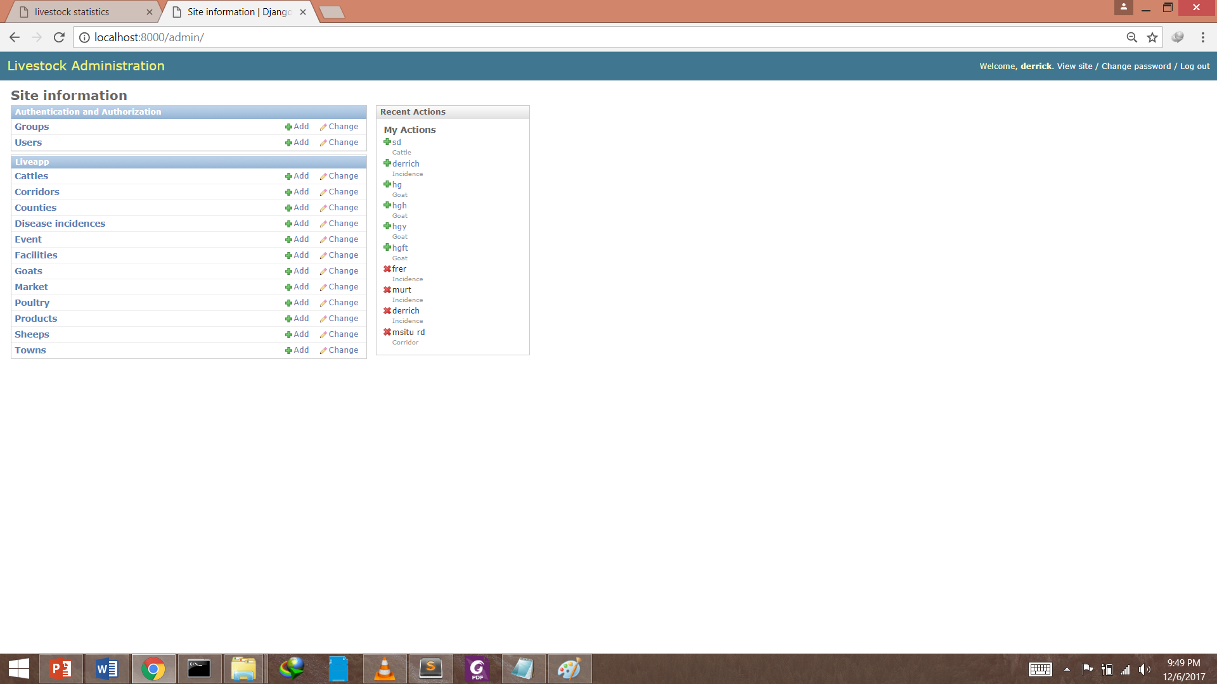
3. Livestock administration. (for crud operations of data and application.)

Slide 14
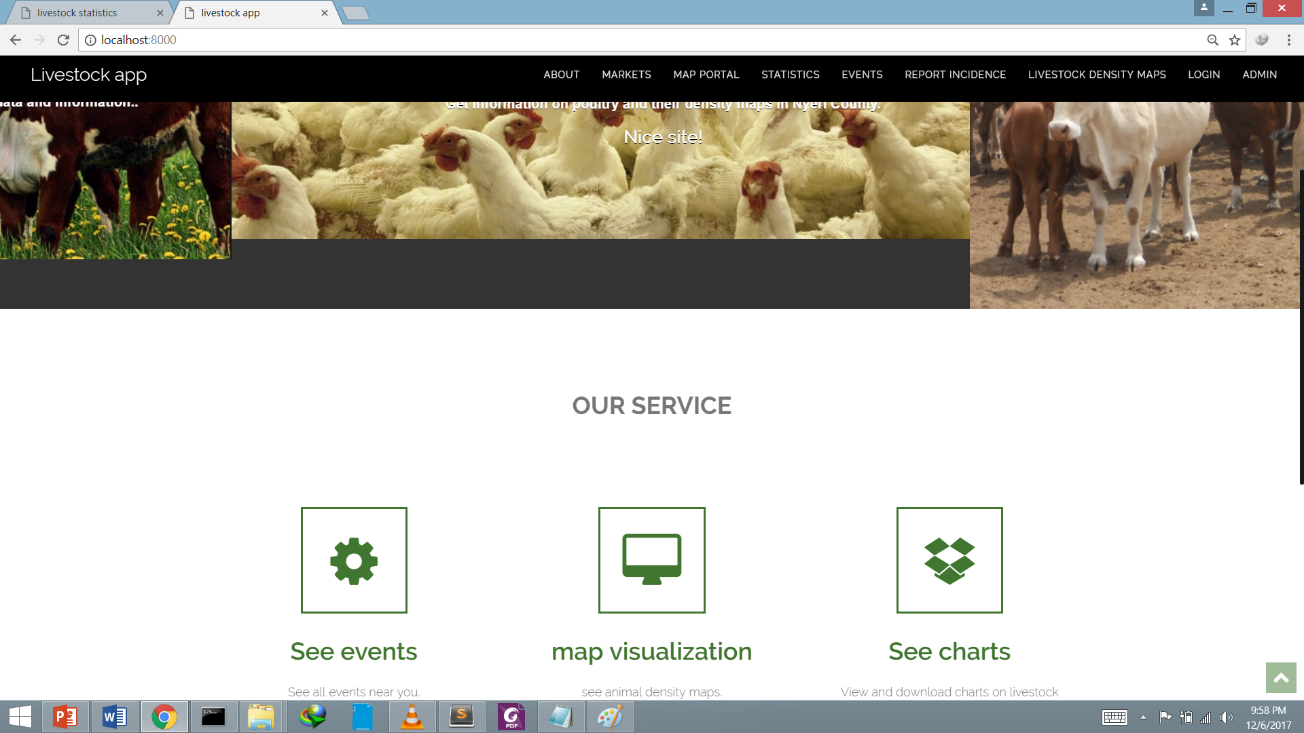
4. Landing page

Slide 15
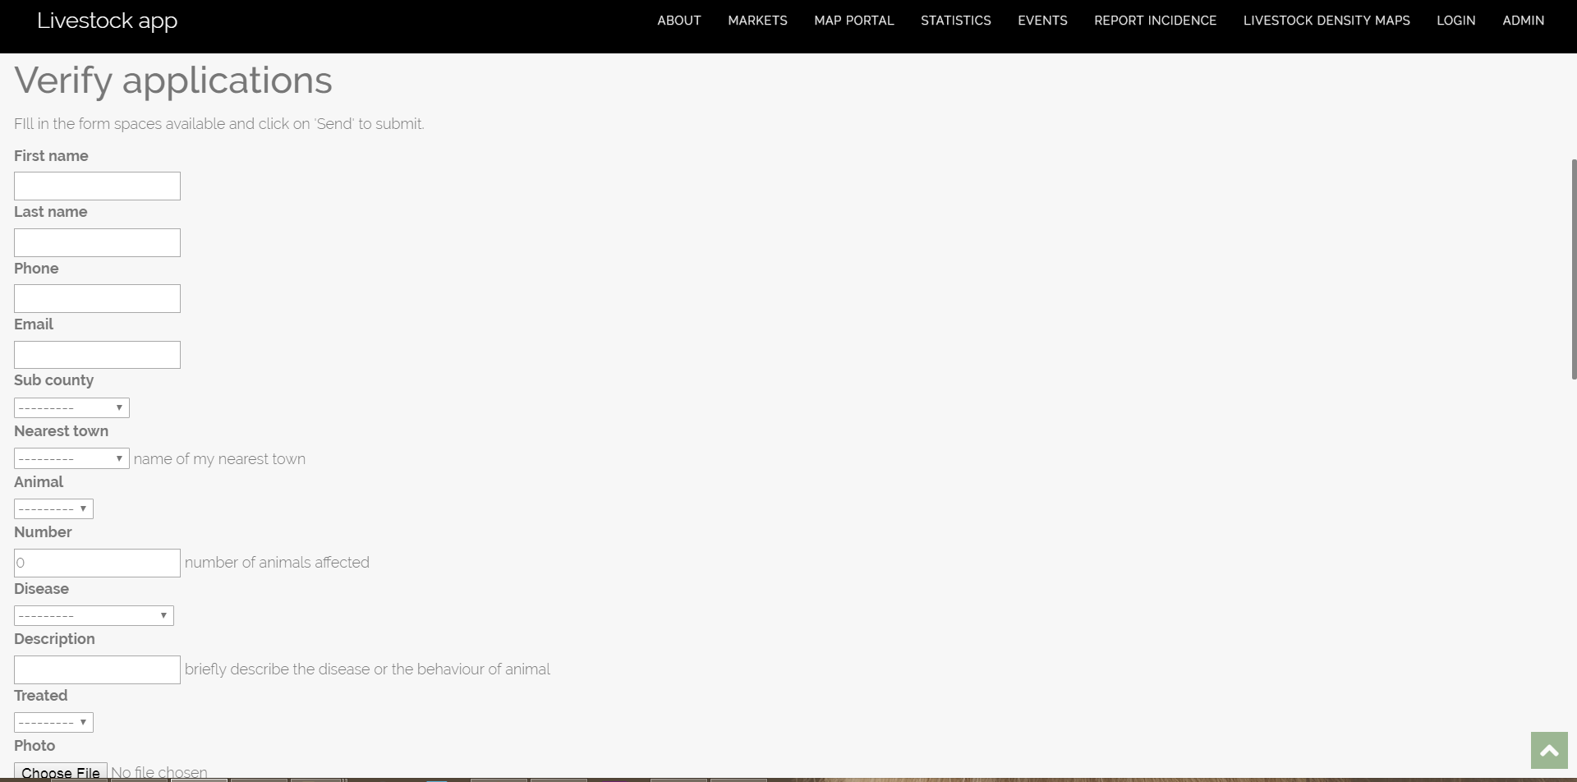
Results cont.. 5. incidence report form(landing page of the applicaction.).

Slide 16
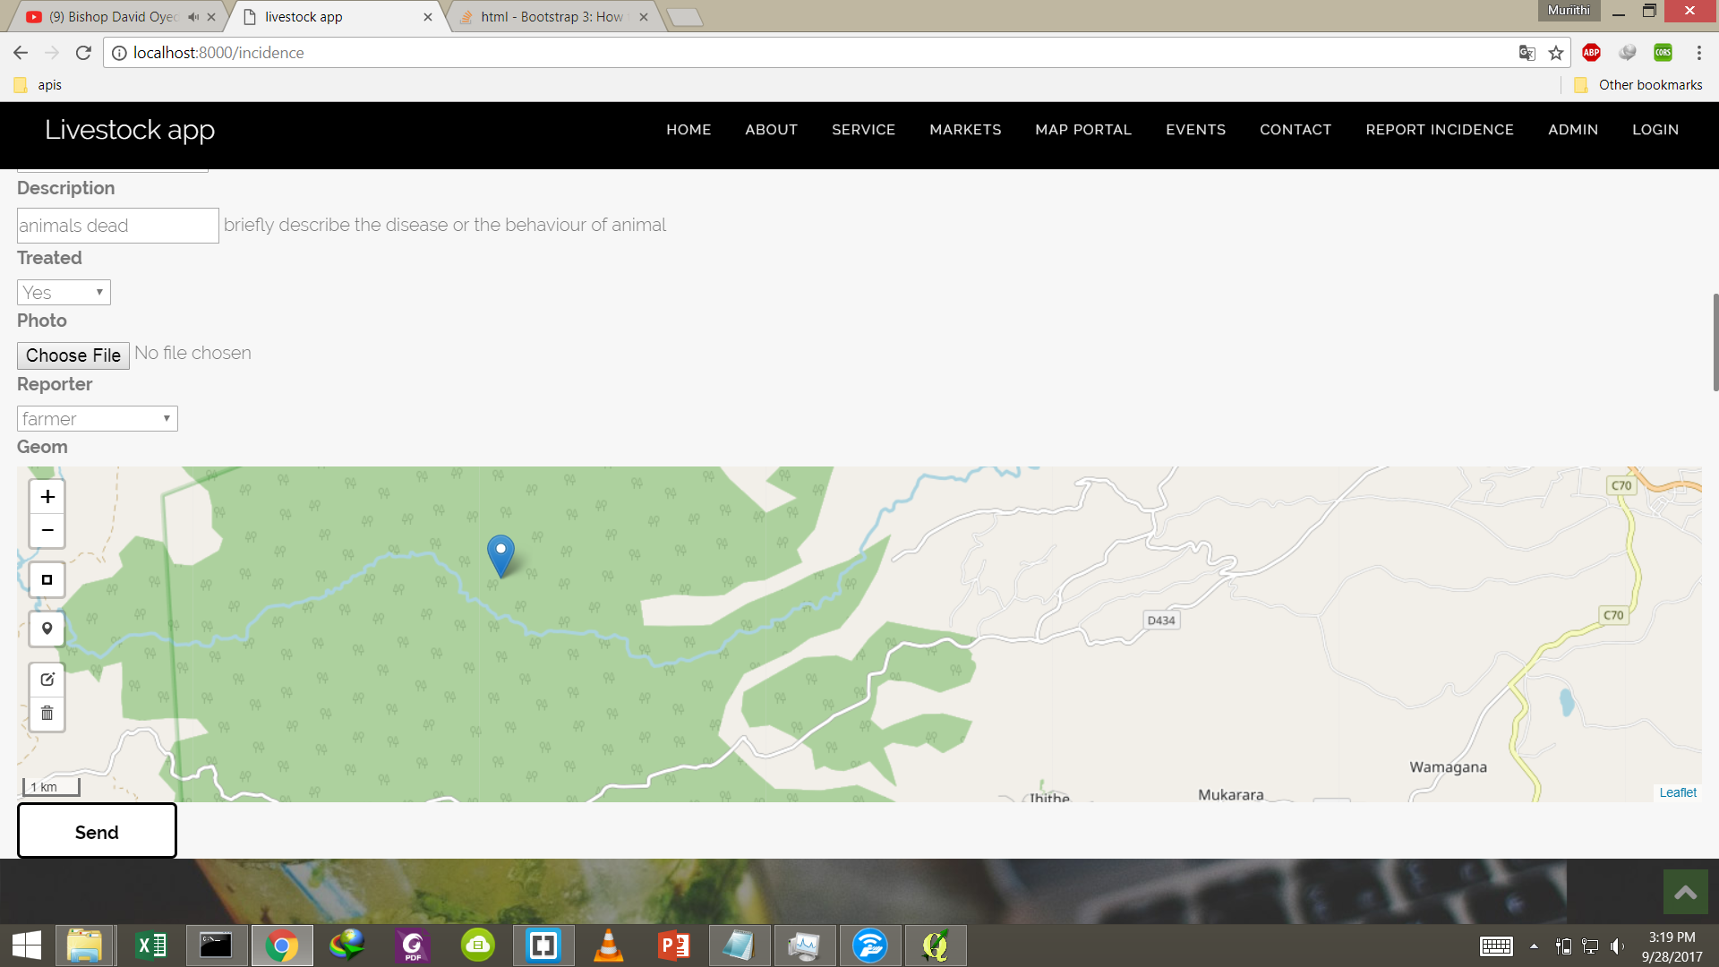
Cont … Incidence report form

Slide 17
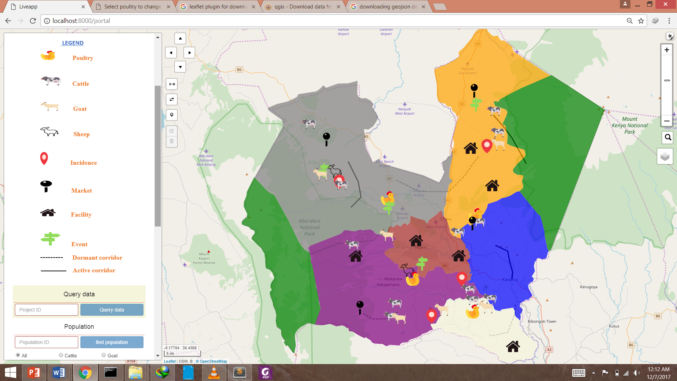
6. Map portal. (operations query, filter and draw features.)

Slide 18
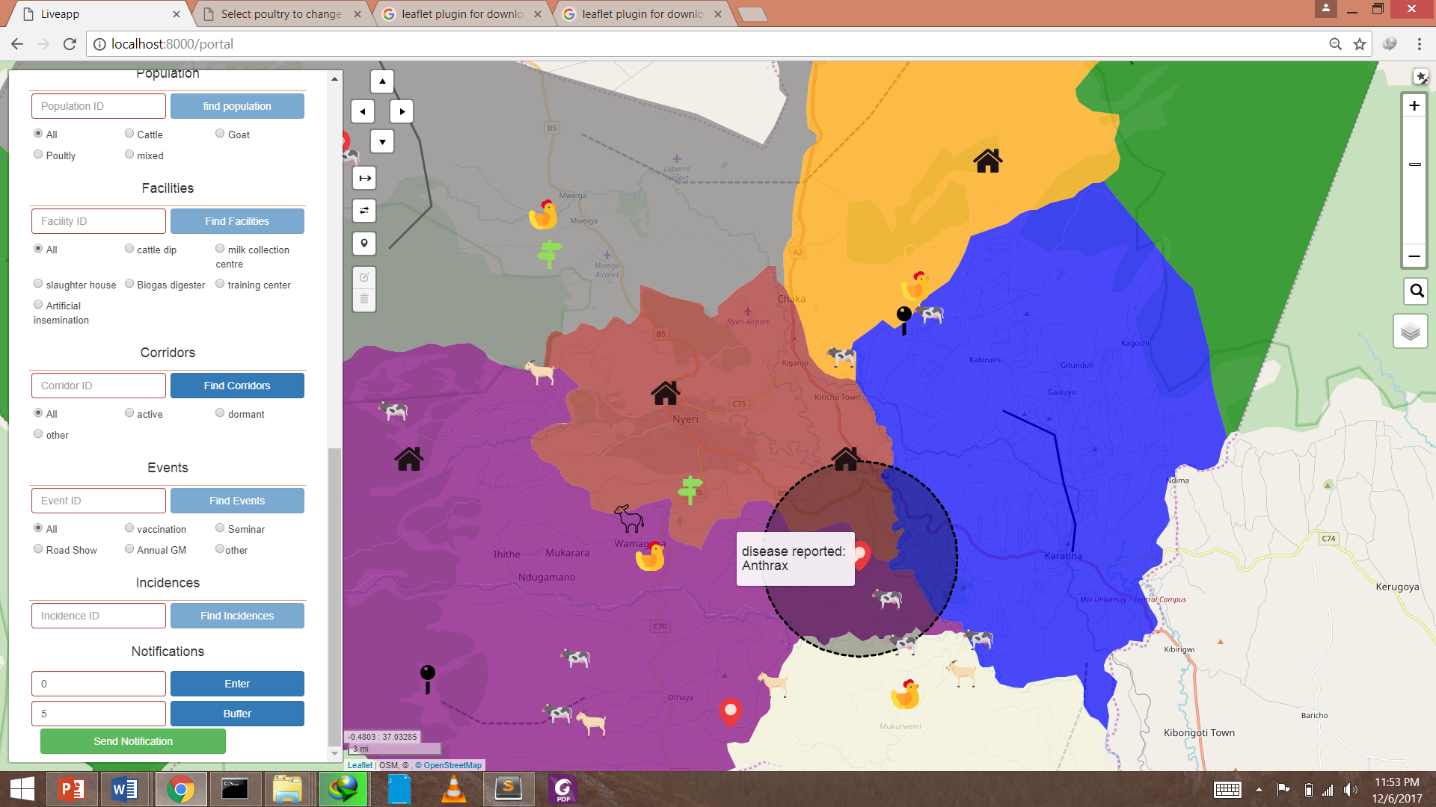
7. Spatial analysis capability. 1.generation of buffers on fly and SMS .

Slide 19
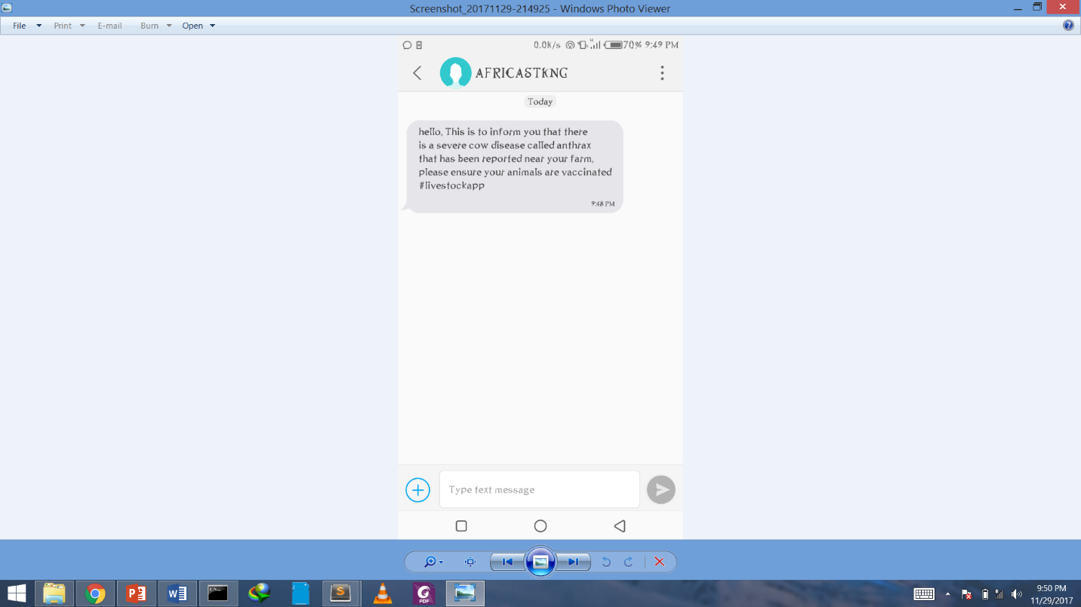
Cont…

Slide 20
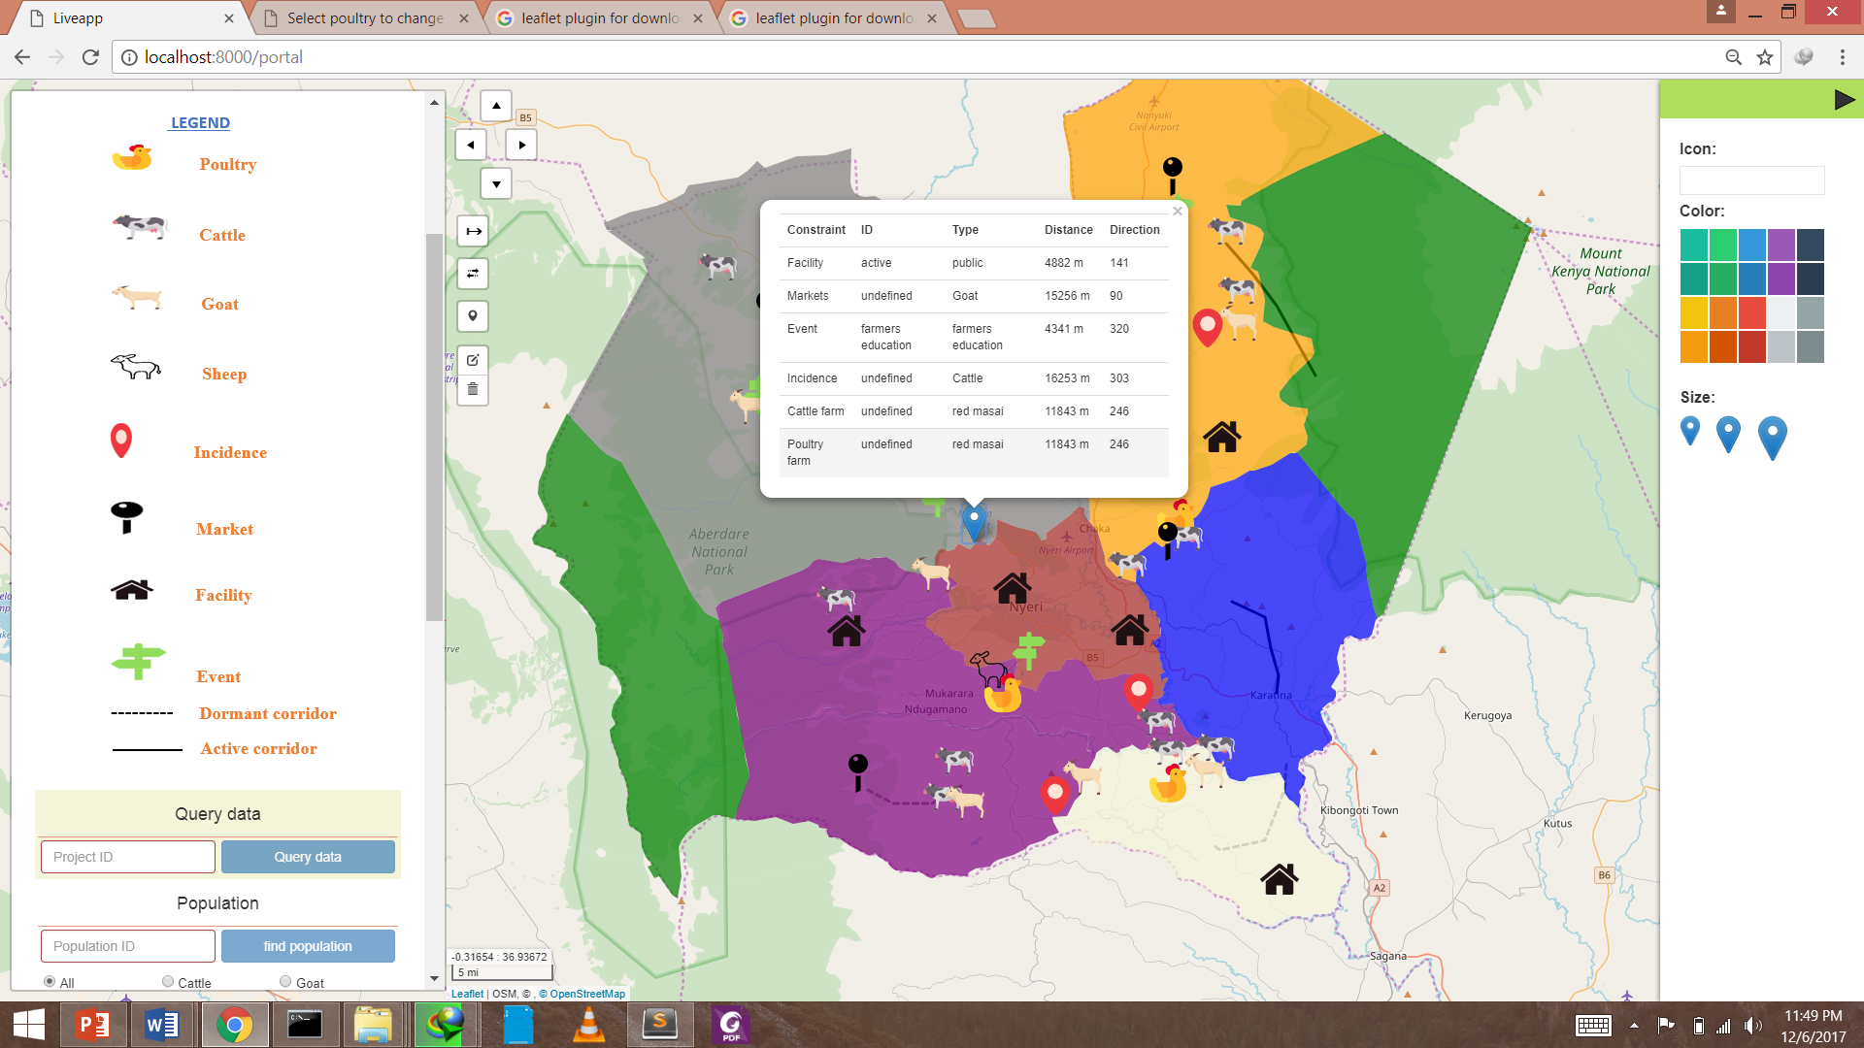
8. Proximity and direction determination. Nearest facility analysis.

Slide 21
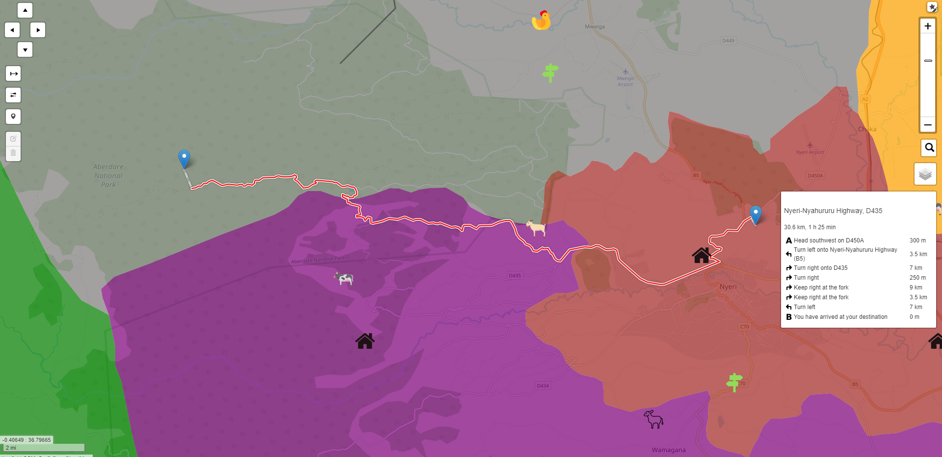
9. Routing functionality. (for guided navigation purposes - on road.)

Slide 22
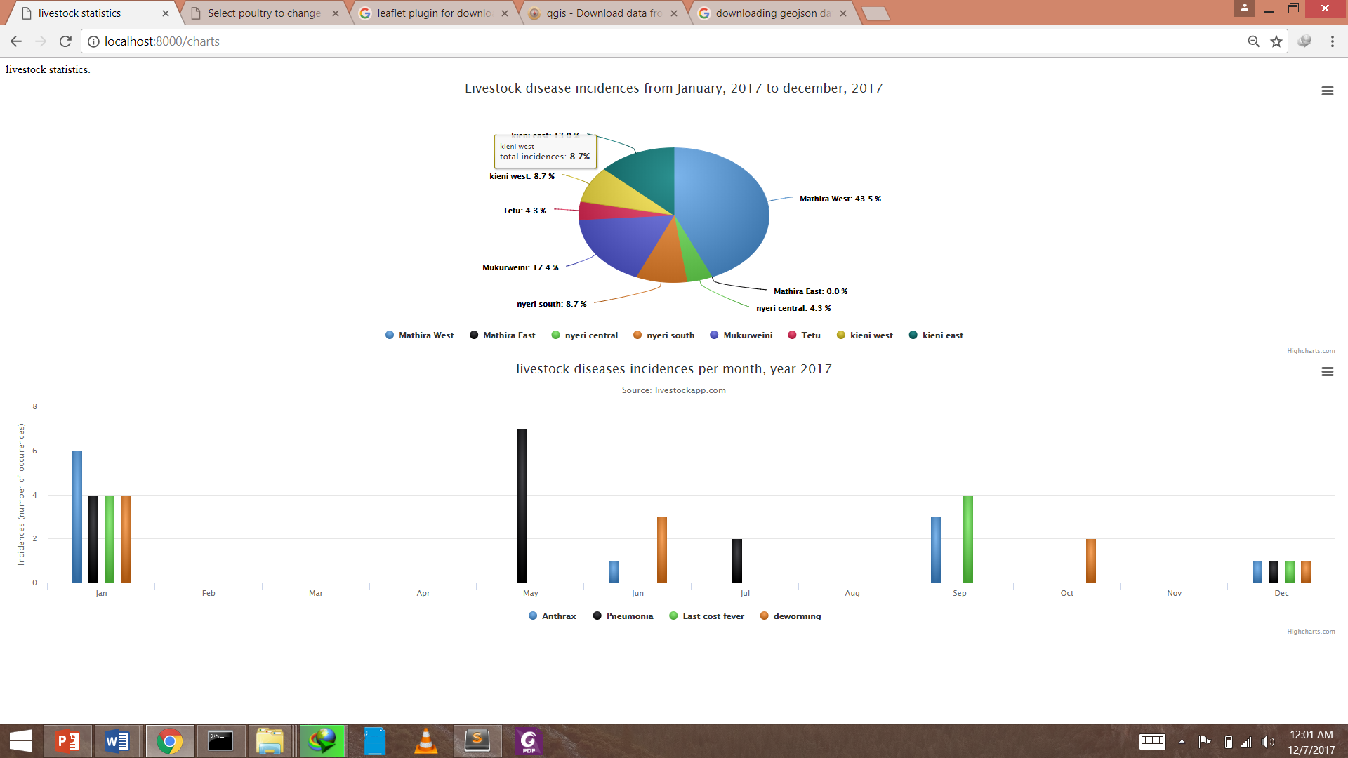
10. Statistical analysis and visualization.

Slide 23
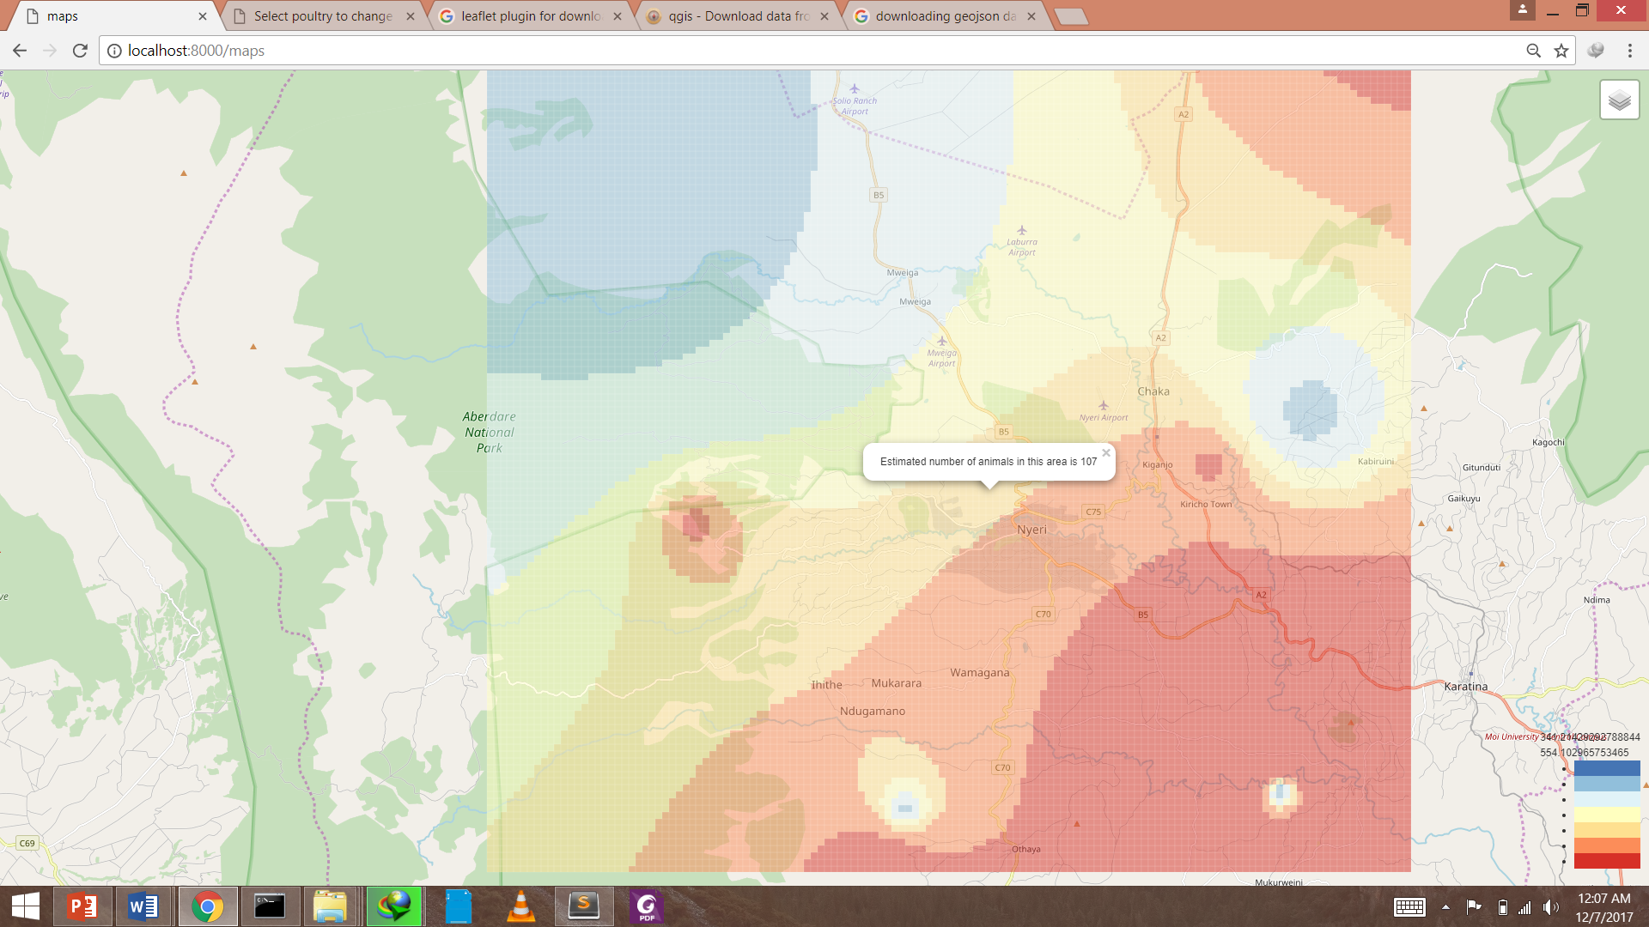
10. Visualization cattle Density maps.

Slide 24
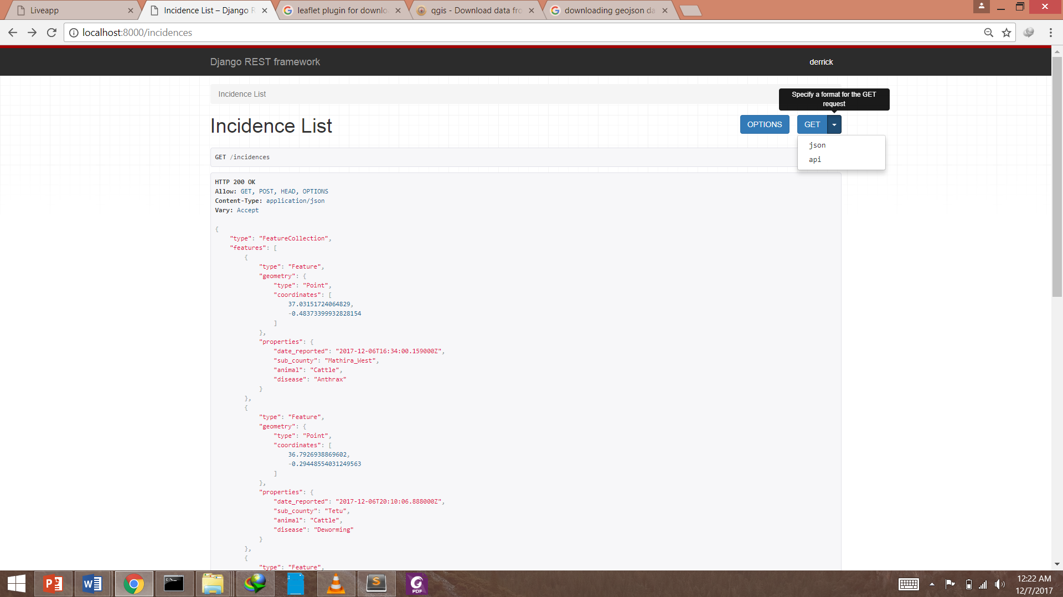
11. Data sharing. Restful framework for data sharing(json and api)

Slide 25
conclusion
Web based spatial decision systems with strong GIS capabilities like client side geoprocessing can aid and ease decision making.

Slide 26
Recommendations.
More client-side tools for spatial analysis need to be embraced to make more decisions to aid the LSDSS.
Embrace and adoption of the LSDSS.
Development of a mobile version to ensure efficiency in simplicity and use.
Sophisticated reports from the application and statistical reports and markets analysis.

Slide 27
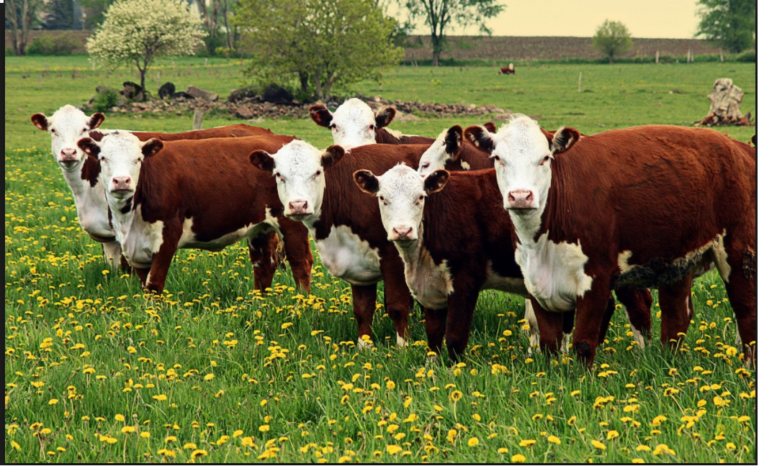
Questions?.
Comments?.
Thank you..

